Slide 1
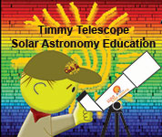
LIVING WITH A
STAR

Slide 2
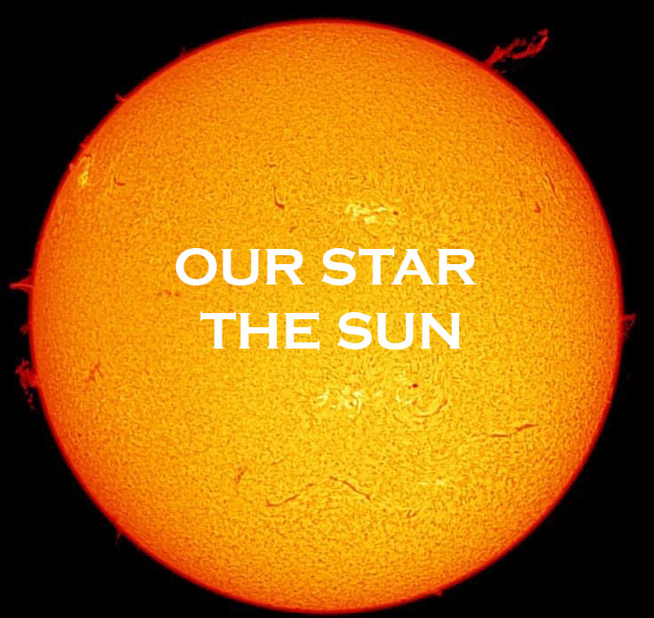

Slide 4
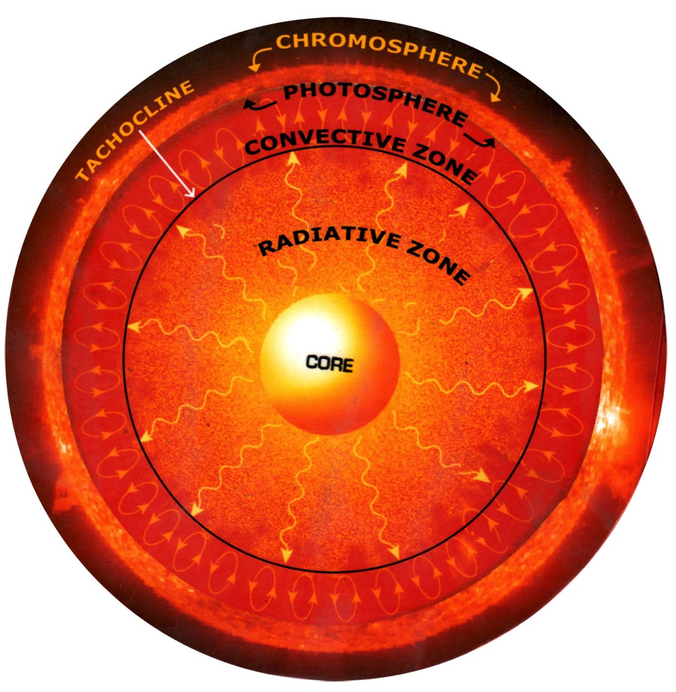
Atmosphere where electrons are free to move
“Surface” where light escapes
Nuclear Fusion

Slide 5
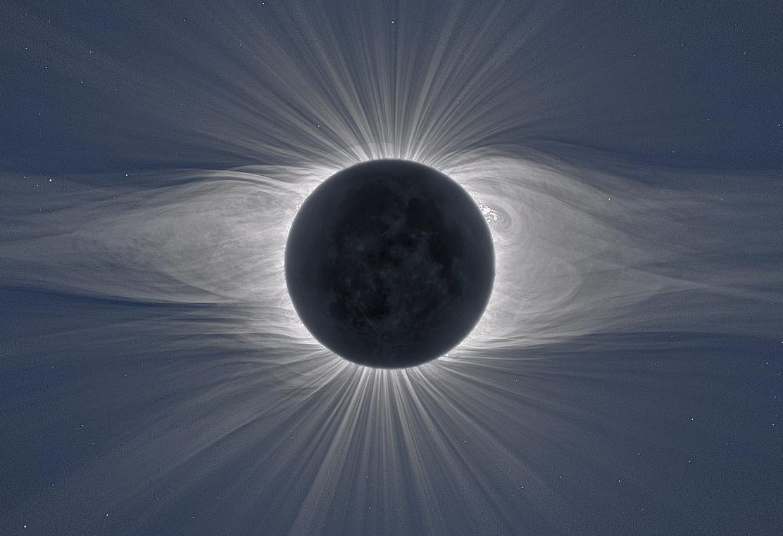
CORONA
Only visible during eclipses

Slide 6
SPEAKING
OF
ECLIPSES
Monday 8 April, 2024

Slide 7
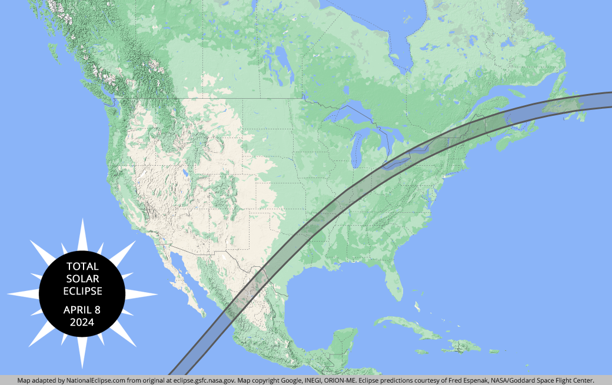
We Are Here

Slide 9
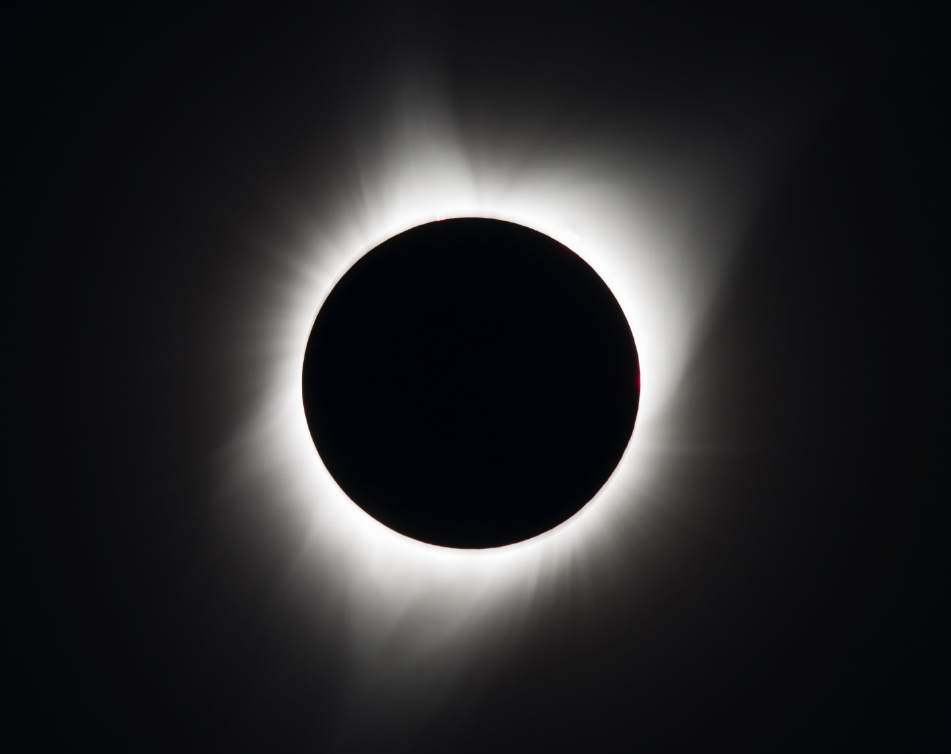
Total Eclipse
Moon is closer to Earth
Mon Apr 8

Slide 10
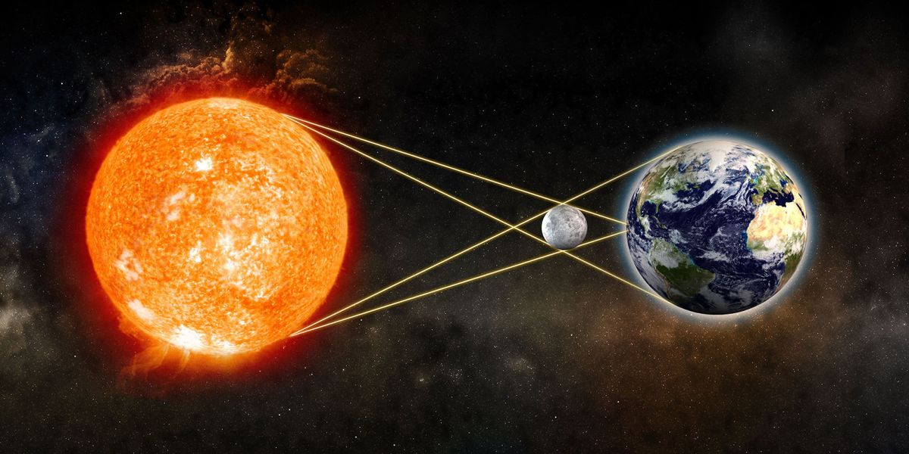
Eclipse Sun-Moon-Earth alignment

Slide 11
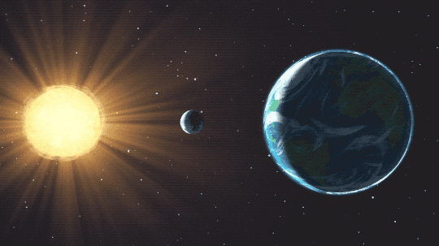

Slide 12
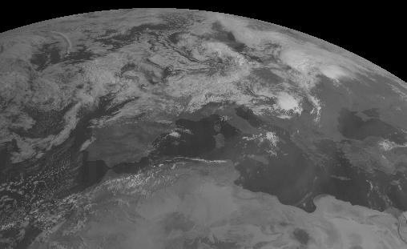

Slide 14
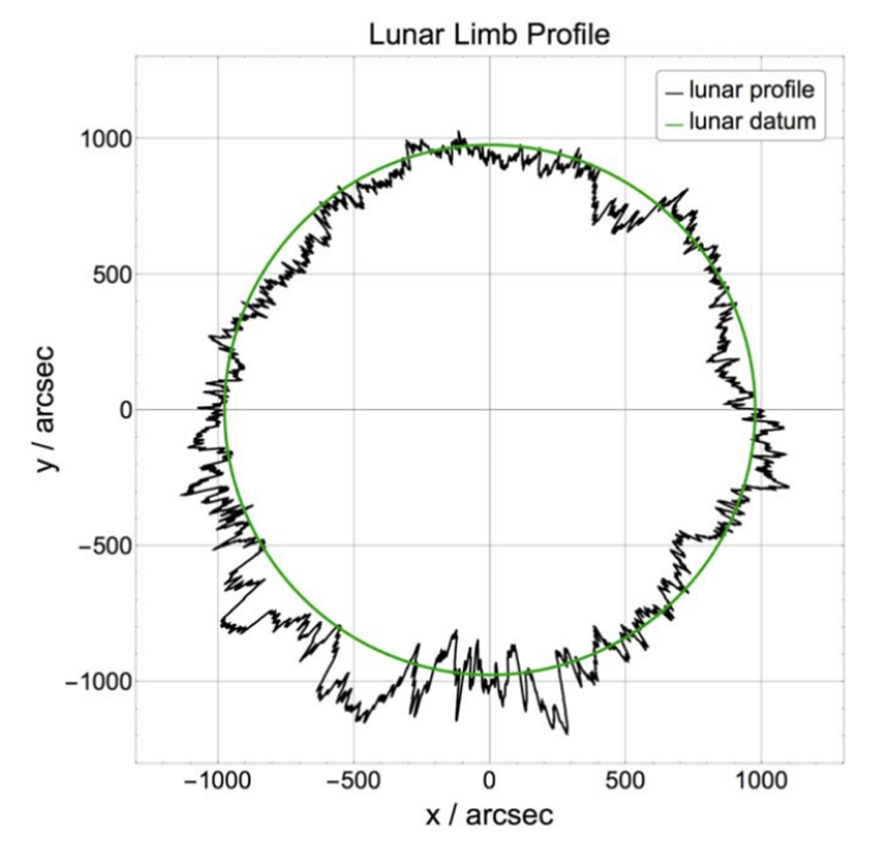
The surface of the moon has Mountains and Valleys

Slide 15
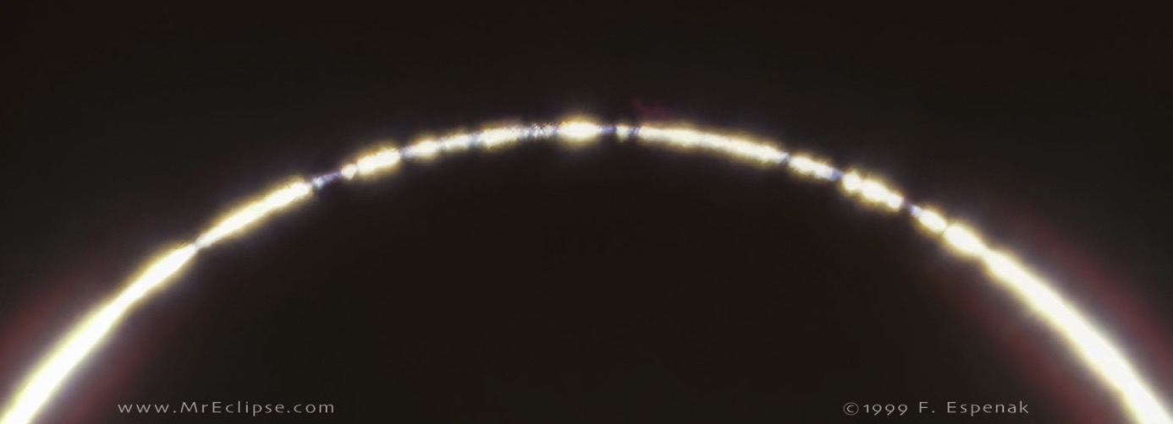
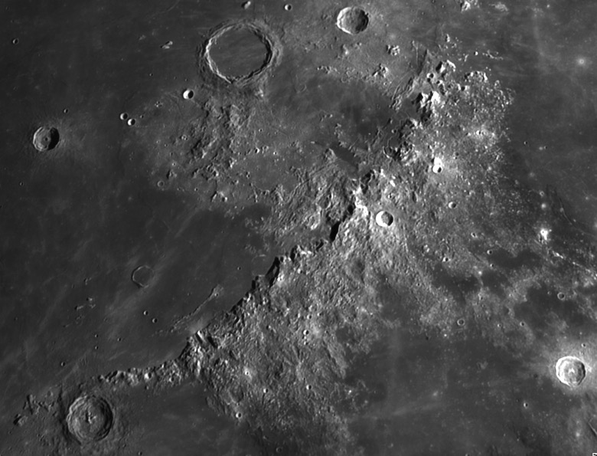
Surface of the Moon

Slide 16
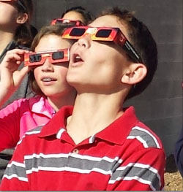
SAFELY VIEWING THE
ECLIPSES
SPECIAL SOLAR GLASSES
Filtered telescopes only

Slide 17
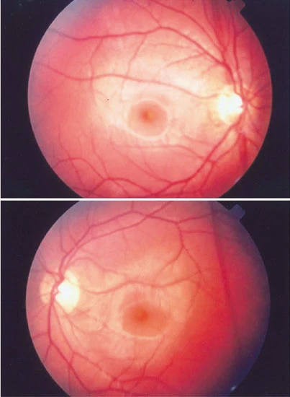
Solar
(Photic) Retinopathy
Permanent
Eye Damage
(Blindness)

Slide 18
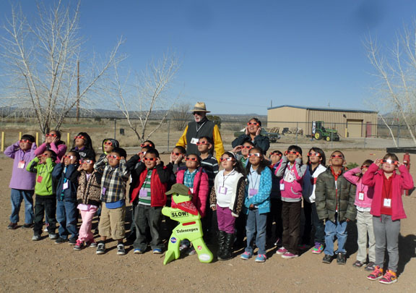

Slide 19
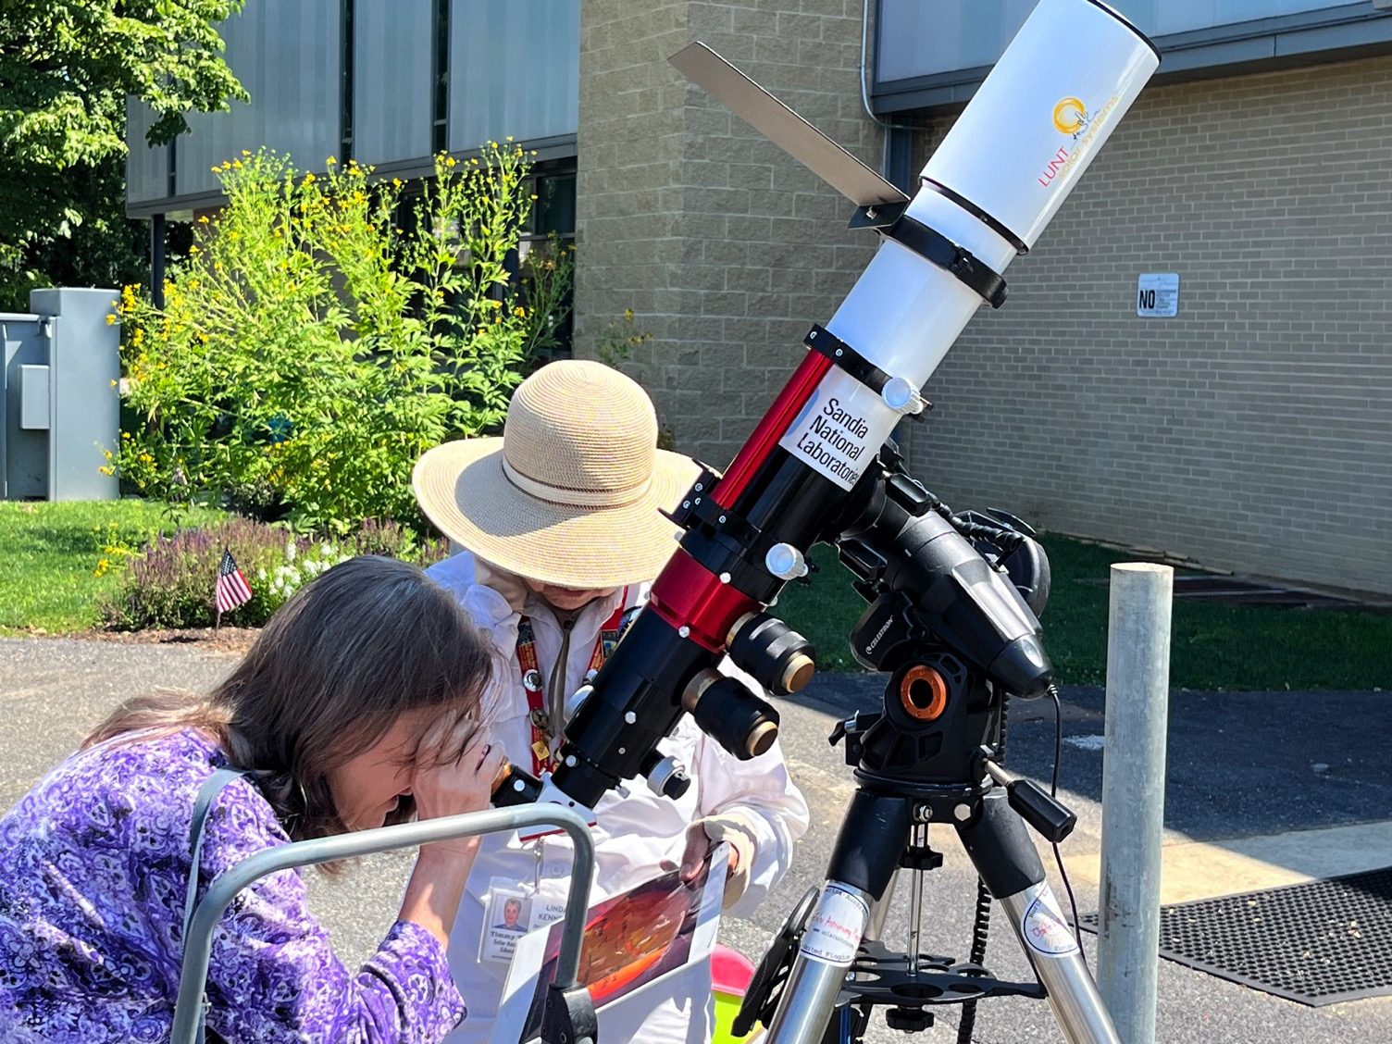
Solar
Telescope

Slide 20
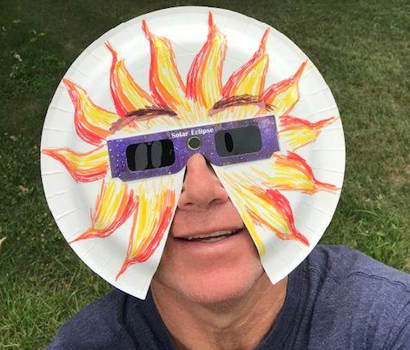
BLING your solar glasses

Slide 21
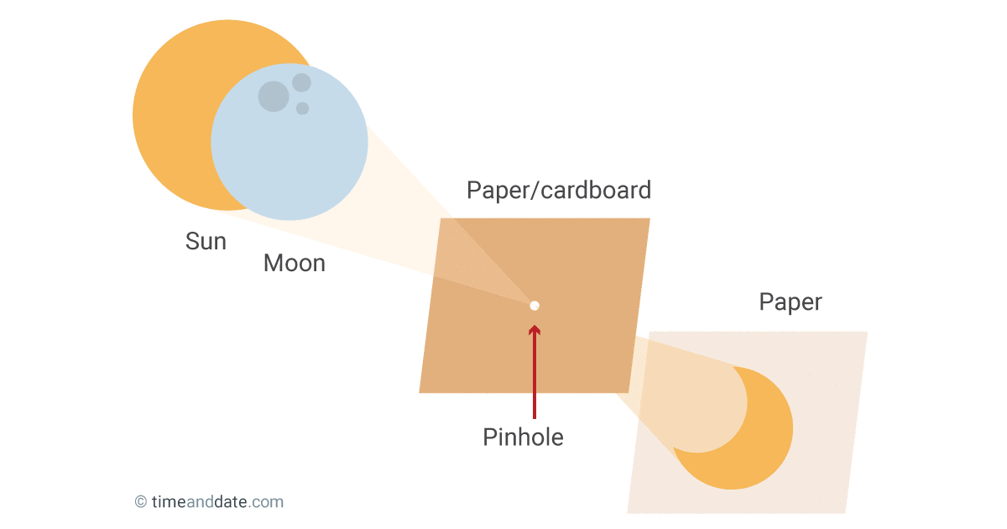
Pinhole projection viewer

Slide 22
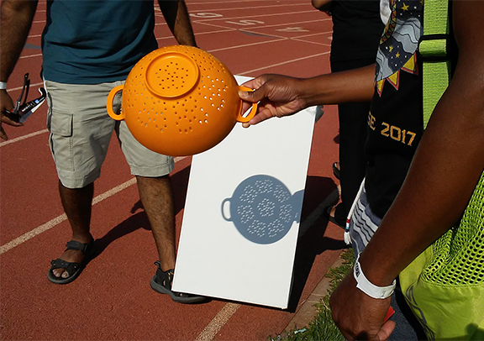

Slide 23
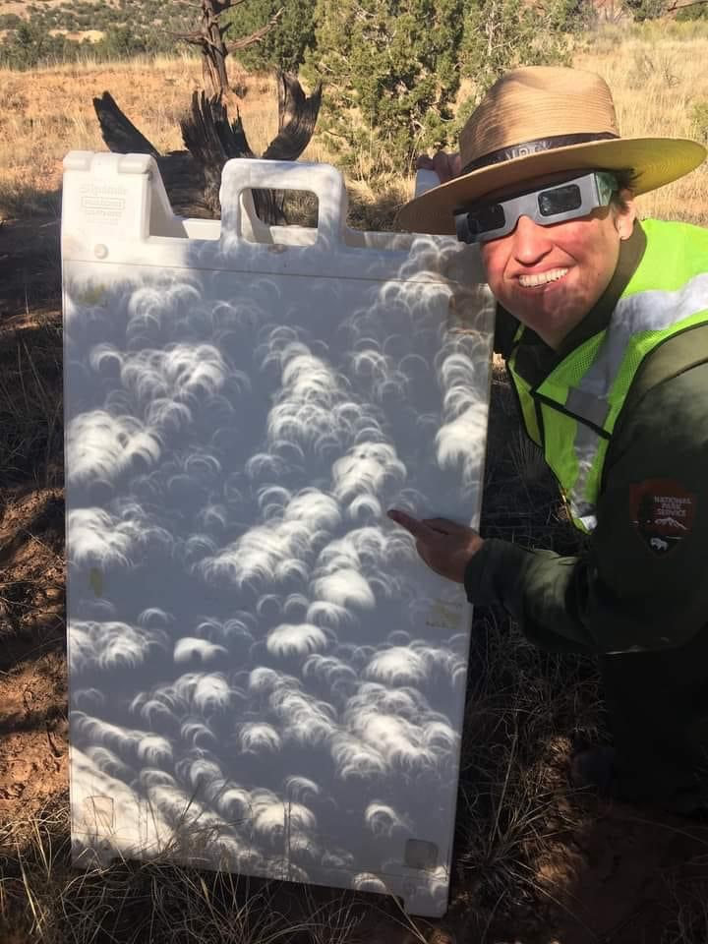

Slide 24
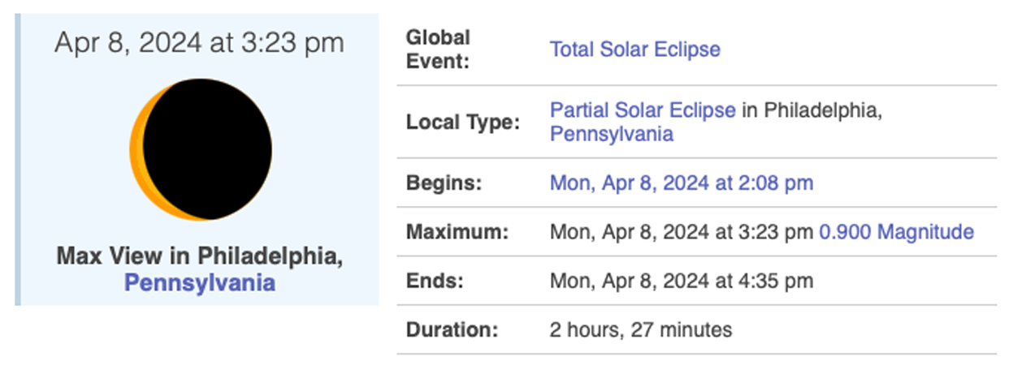
1:59 pm EDT
2024 eclipse from Philadelphia area

Slide 25
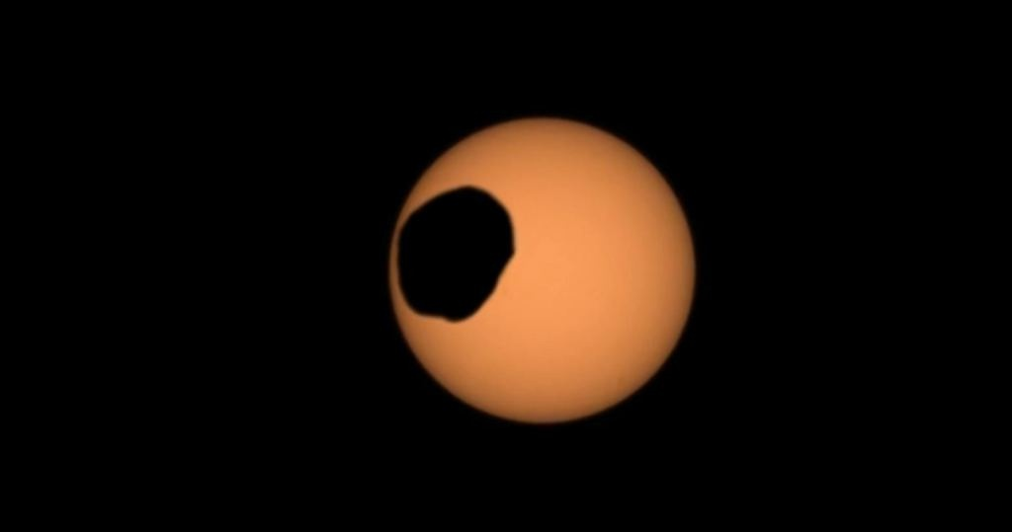
Eclipse on Mars

Slide 26
SOLAR
SCIENCE
(HELIOPHYSICS)

Slide 27
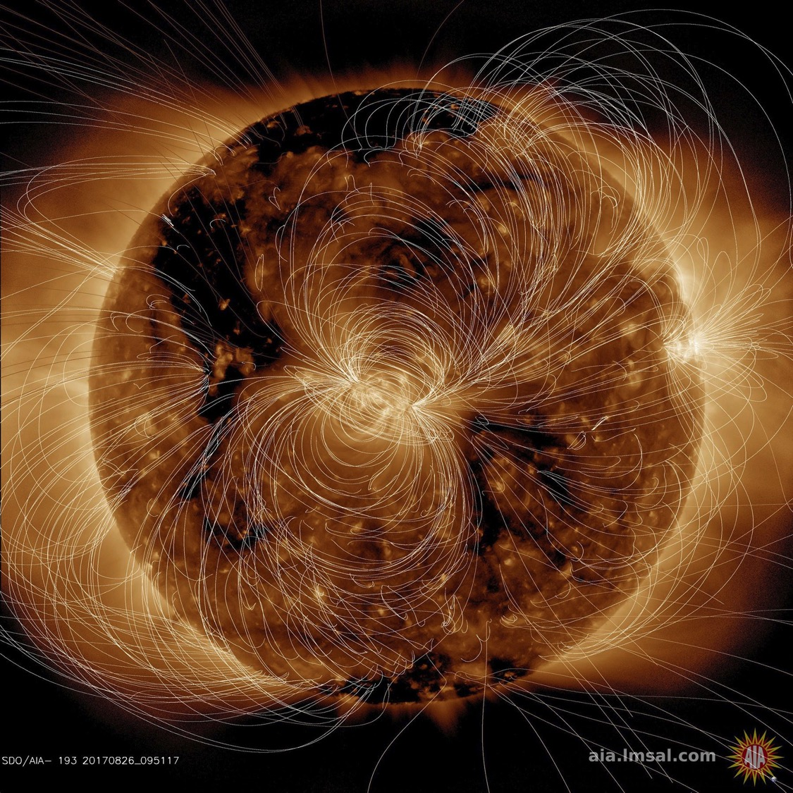
Magnetic Field Lines

Slide 28
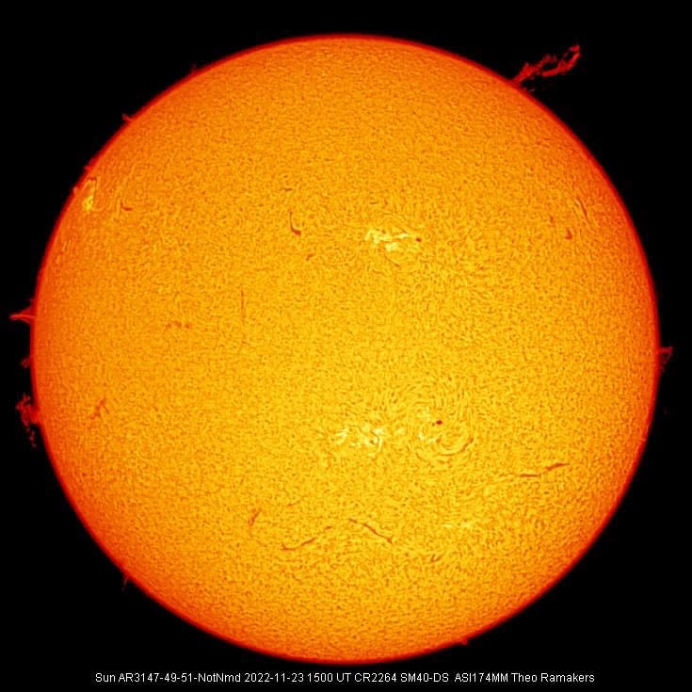
Prominences imaged with a Hydrogen-alpha
Earth based telescope

Slide 29
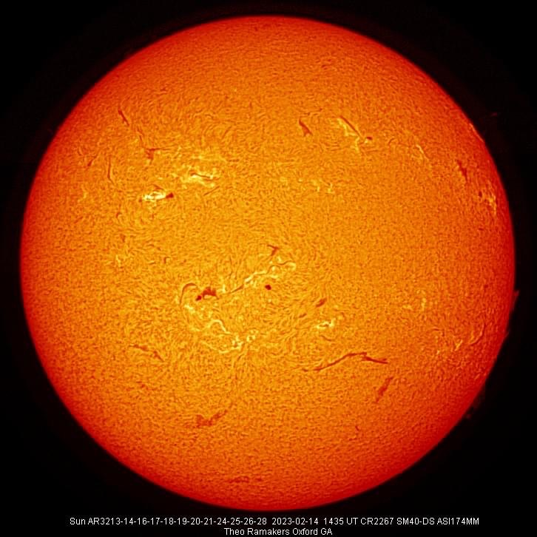
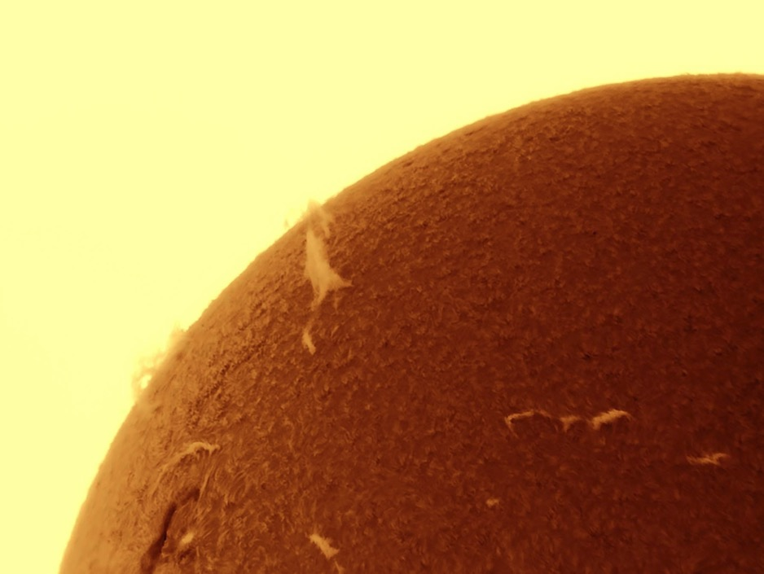
Solar Filament

Slide 30
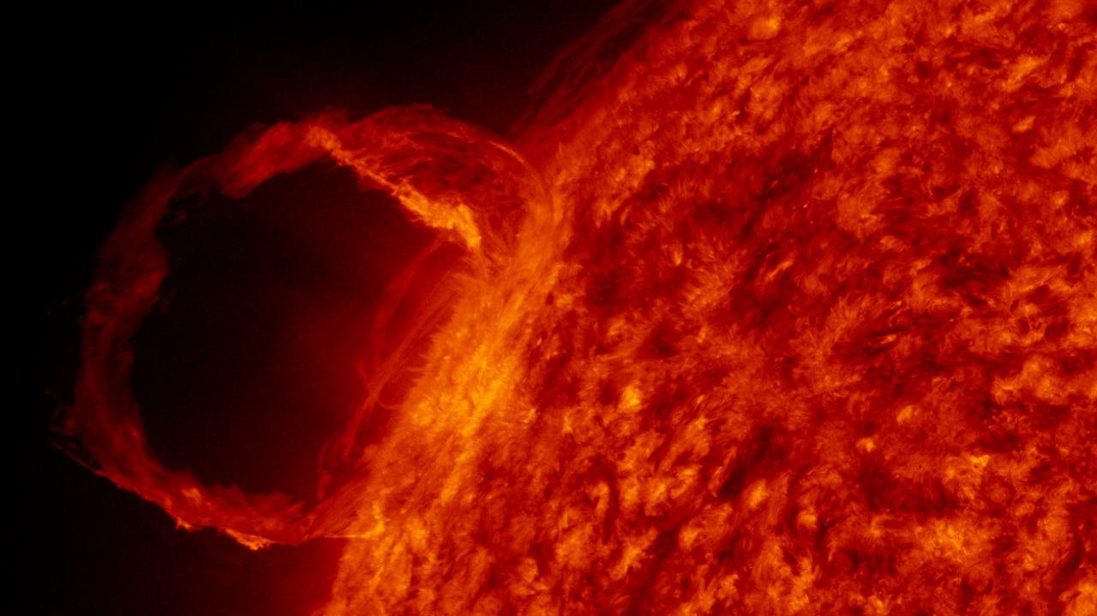
Solar Prominences and Filaments
can occur anytime

Slide 31
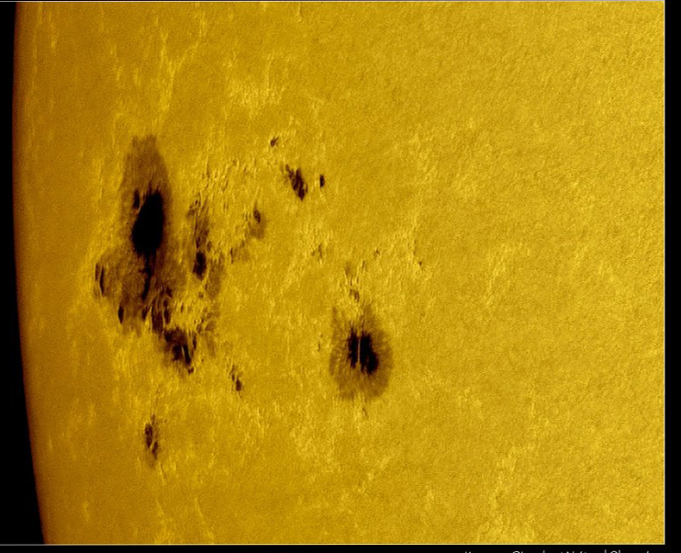
Sunspots
Solar magnetic storms

Slide 32
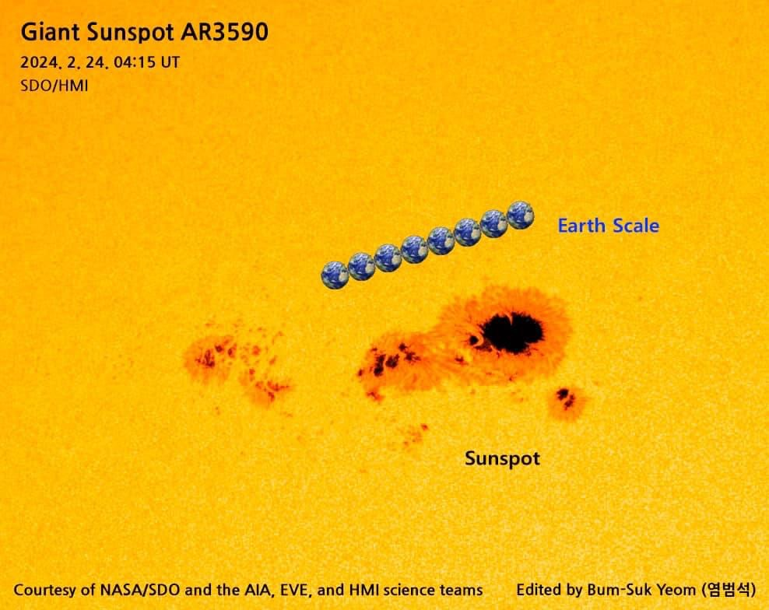

Slide 33
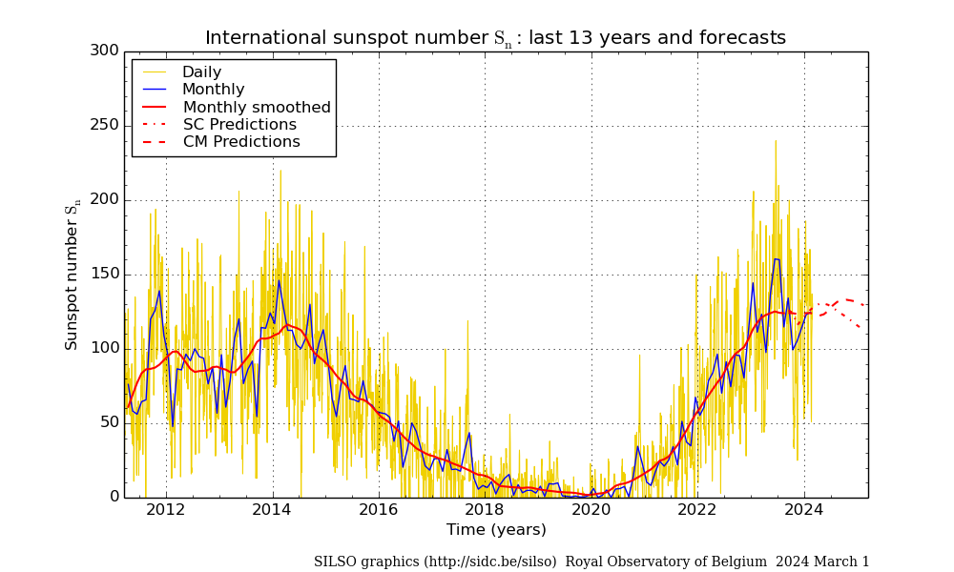

Slide 34
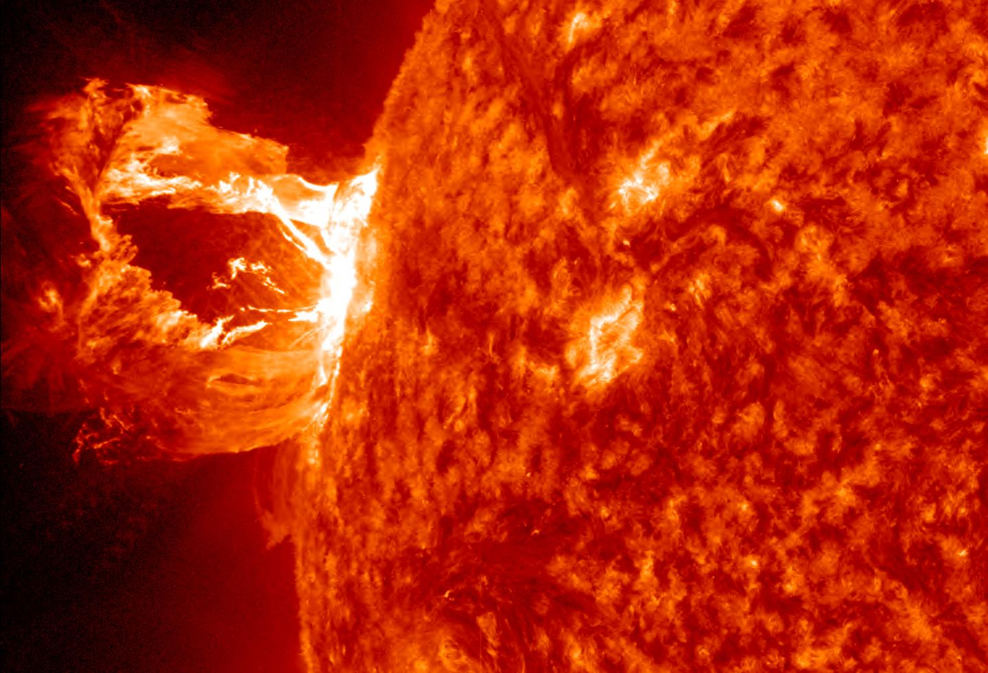
Plasma eruption
Solar Flare

Slide 35
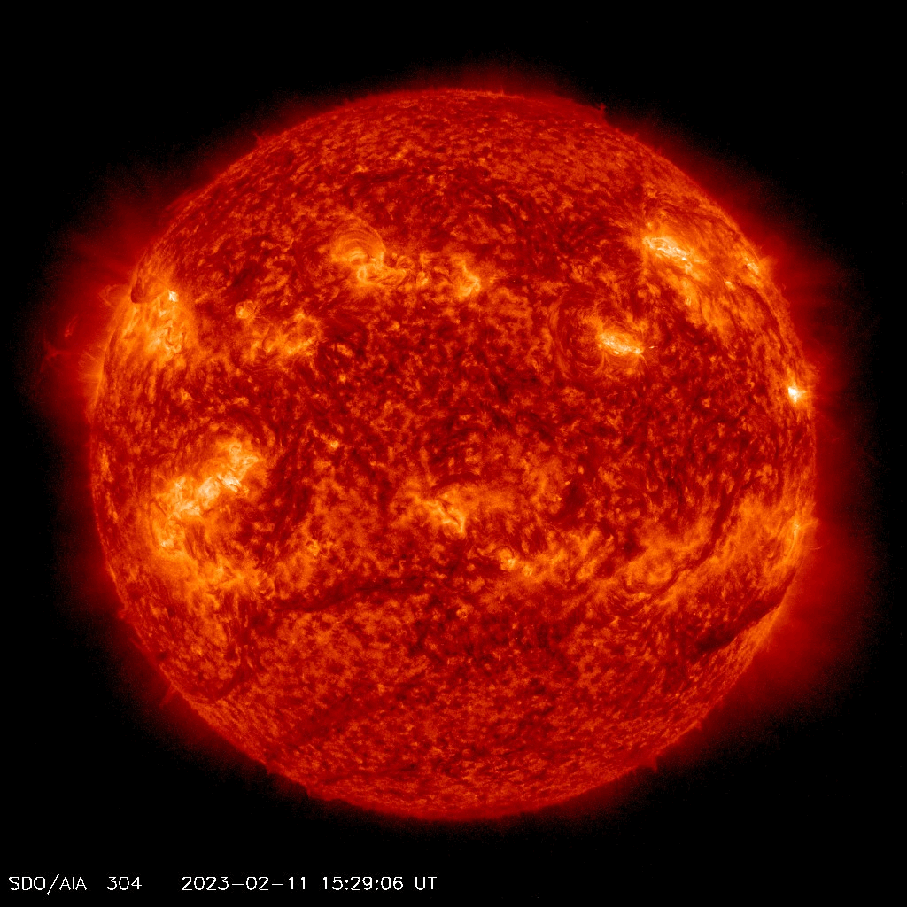
X class solar flares are the most energetic type

Slide 36
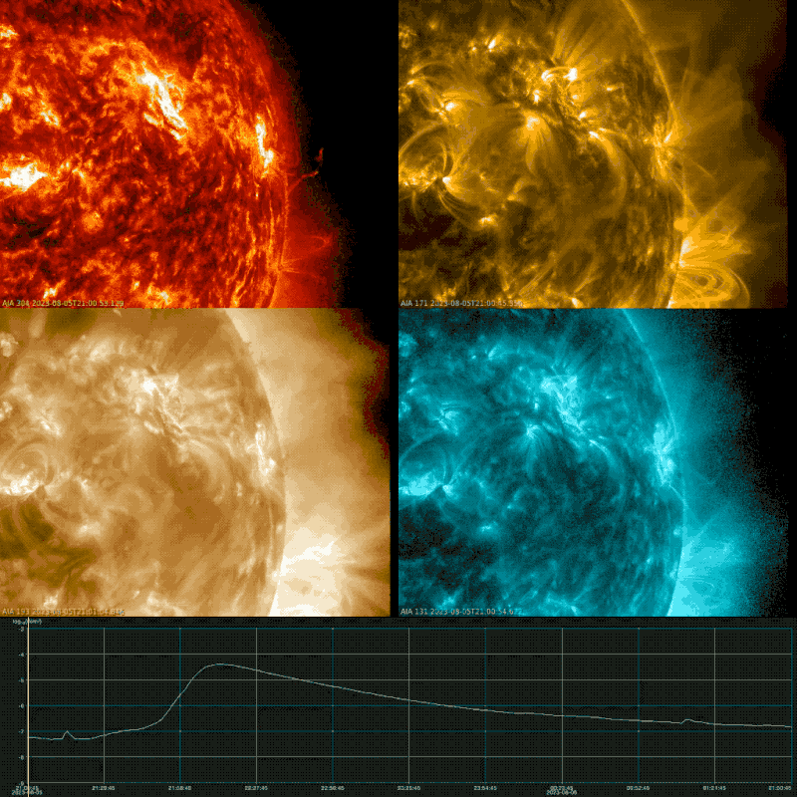
X Class Flare
5-6 Aug 2023
4 different wavelengths
SDO, GOES
304,171,193,131nm UV Filters

Slide 37
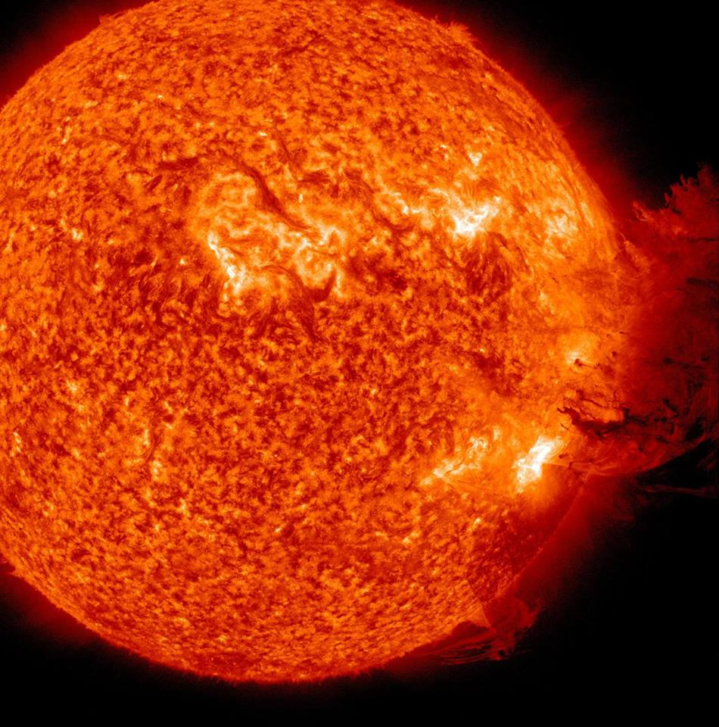
Coronal
Mass
Ejection

Slide 38
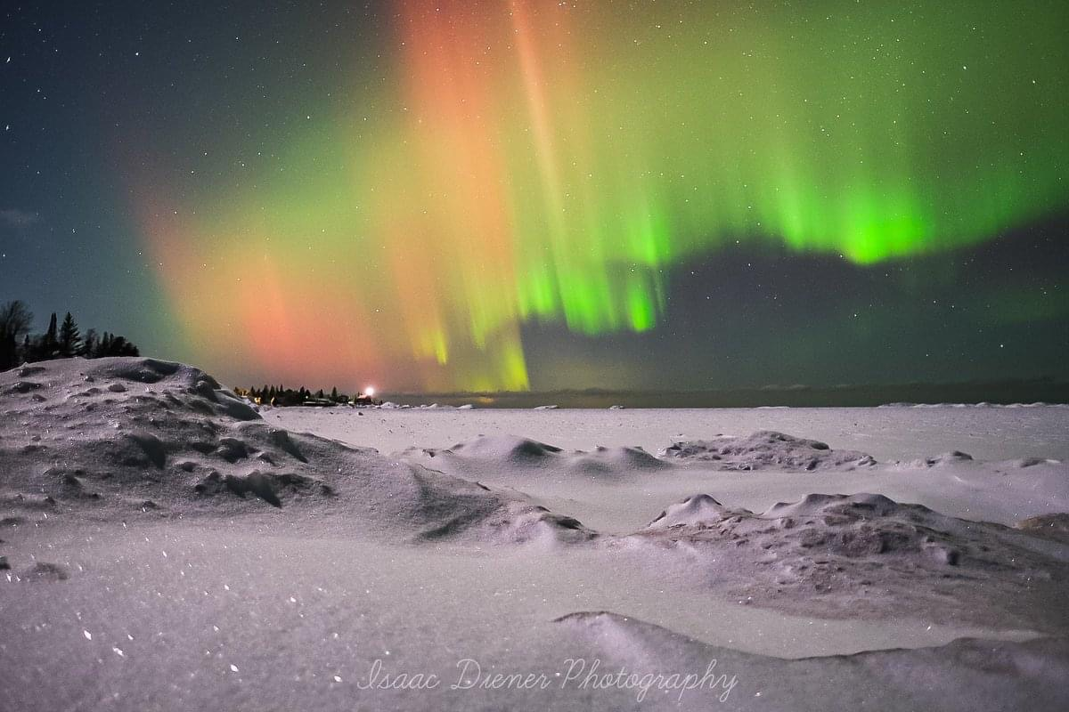
AURORA

